Slide 1


Azərbaycan Dövlət Neft və Sənaye Universiteti
Calculus
Single Variable

Slide 2
Integration:
Riemann Sums

Slide 3
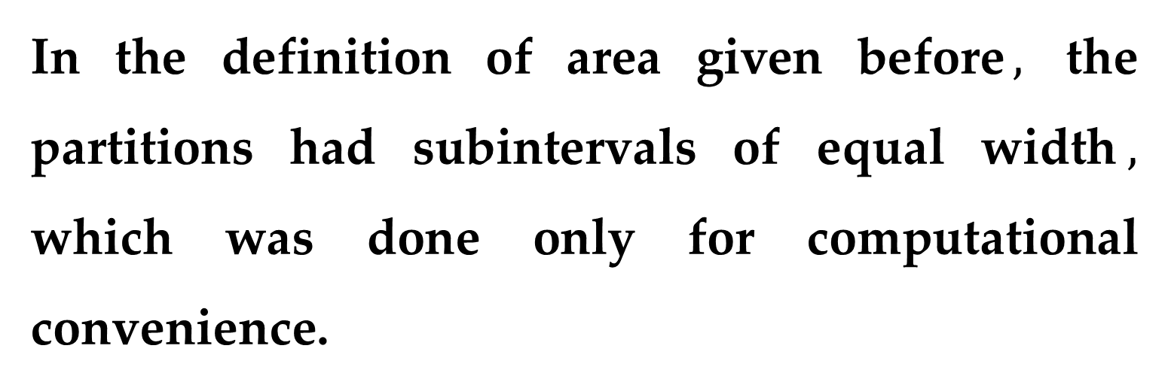
In the definition of area given before$,$ the partitions had subintervals of equal width$,$ which was done only for computational convenience.
The next example shows that it is not necessary to have subintervals of equal width.

Slide 4
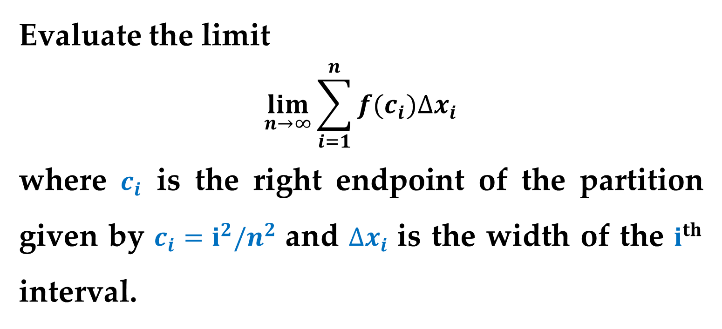
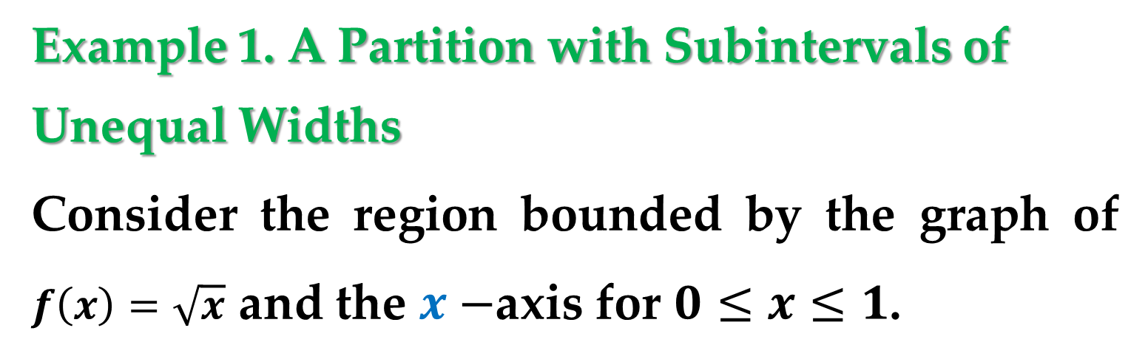
Example 1. A Partition with Subintervals of
Unequal Widths
Consider the region bounded by the graph of $f\left(x\right)=\sqrt{x}$ and the $x−$axis for $0≤x≤1$.
Evaluate the limit
$$\lim_{n→∞}{\sum_{i=1}^{n}{f(c_{i})∆x_{i}}}$$
where $c_{i}$ is the right endpoint of the partition given by $c_{i}=i^{2}/n^{2}$ and $∆x_{i}$ is the width of the $i^{th}$ interval.

Slide 5
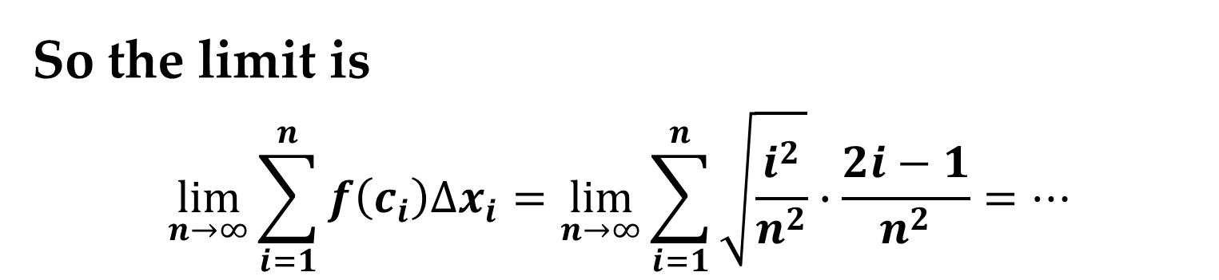
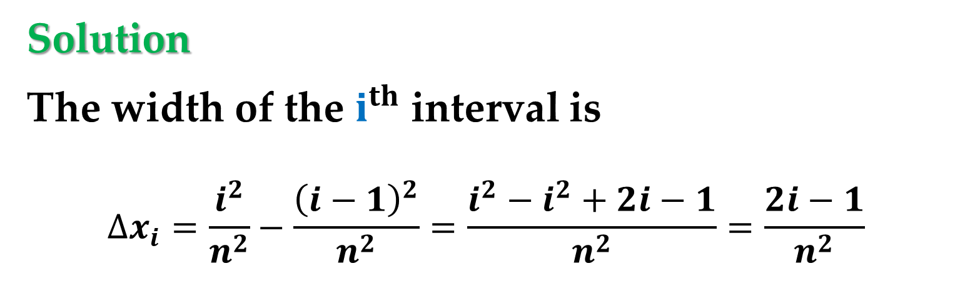
Solution
The width of the $i^{th}$ interval is
$$∆x_{i}=\frac{i^{2}}{n^{2}}−\frac{{\left(i−1\right)}^{2}}{n^{2}}=\frac{i^{2}−i^{2}+2i−1}{n^{2}}=\frac{2i−1}{n^{2}}$$
So the limit is
$$\lim_{n→∞}{\sum_{i=1}^{n}{f\left(c_{i}\right)∆x_{i}}}=\lim_{n→∞}{\sum_{i=1}^{n}{\sqrt{\frac{i^{2}}{n^{2}}}∙\frac{2i−1}{n^{2}}}}=…$$

Slide 6

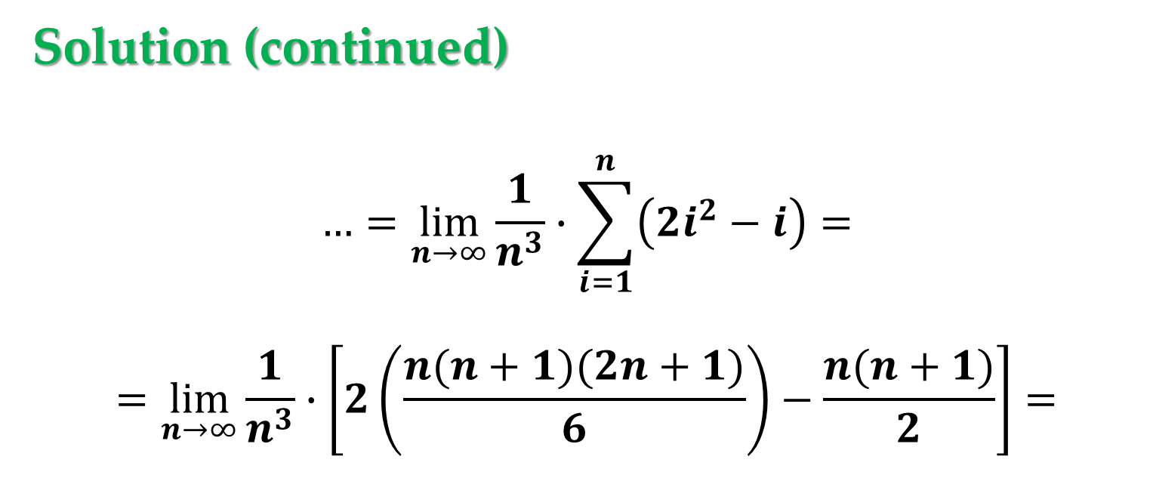
Solution (continued)
$$…=\lim_{n→∞}{\frac{1}{n^{3}}∙\sum_{i=1}^{n}{\left(2i^{2}−i\right)}}=$$
$$=\lim_{n→∞}{\frac{1}{n^{3}}∙\left[2\left(\frac{n(n+1)(2n+1)}{6}\right)−\frac{n(n+1)}{2}\right]}=$$
$$=\lim_{n→∞}\frac{4n^{3}+3n^{2}−n}{6n^{3}}=\frac{2}{3}$$

Slide 7
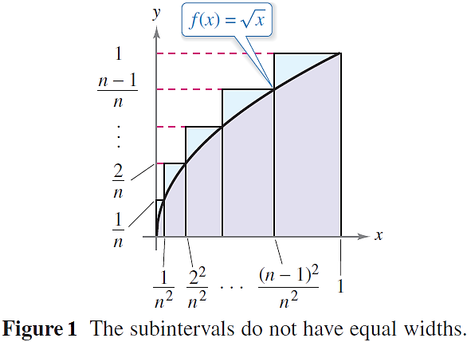
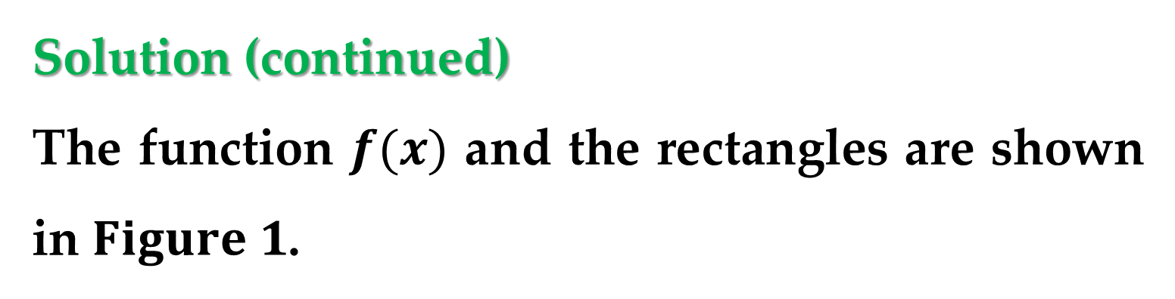
Solution (continued)
The function $f(x)$ and the rectangles are shown in $Figure 1$.

Slide 8
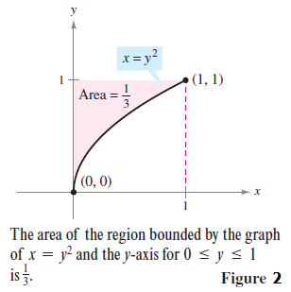
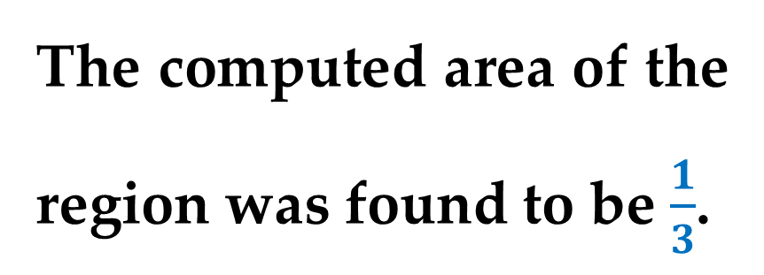
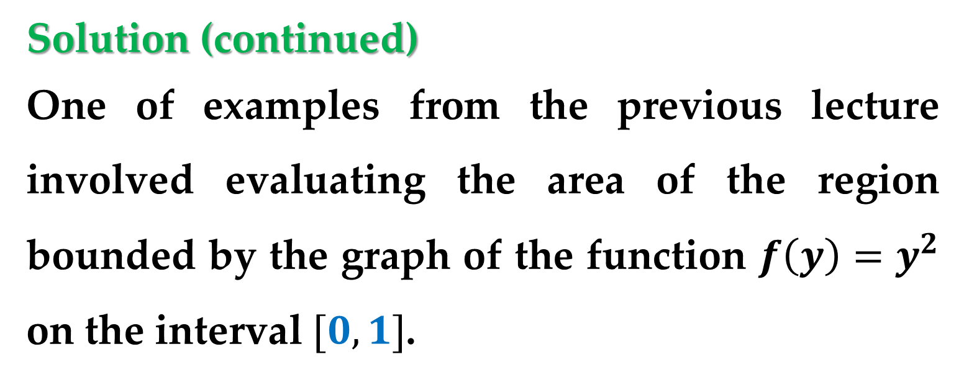
Solution (continued)
One of examples from the previous lecture involved evaluating the area of the region bounded by the graph of the function $f\left(y\right)=y^{2}$ on the interval $[0,1]$.
The computed area of the region was found to be $\frac{1}{3}$.

Slide 9
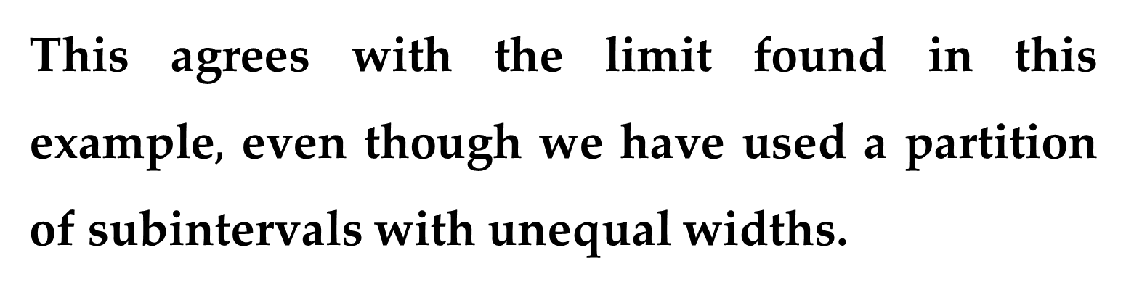
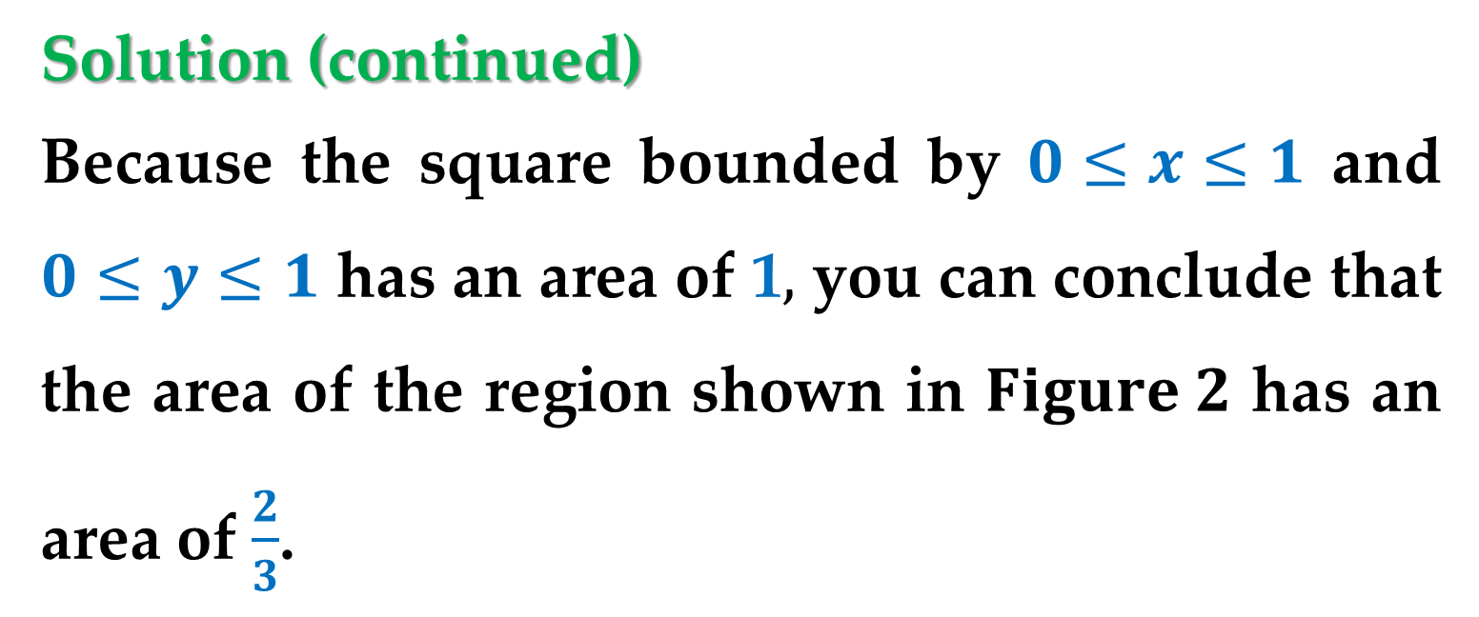
Solution (continued)
Because the square bounded by $0≤x≤1$ and $0≤y≤1$ has an area of 1$,$ you can conclude that the area of the region shown in $Figure 2$ has an area of $\frac{2}{3}$.
This agrees with the limit found in this example$,$ even though we have used a partition of subintervals with unequal widths.

Slide 10
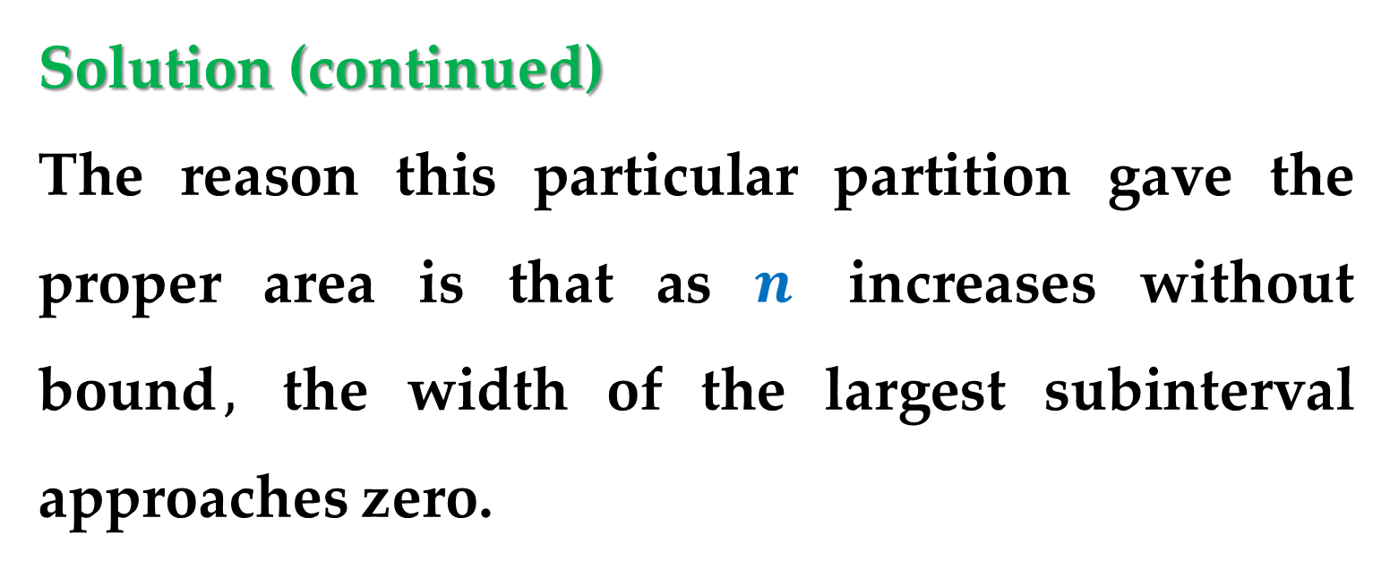
Solution (continued)
The reason this particular partition gave the proper area is that as $n$ increases without bound$,$ the width of the largest subinterval approaches zero.
This observation was a key feature of the development of definite integrals.

Slide 11
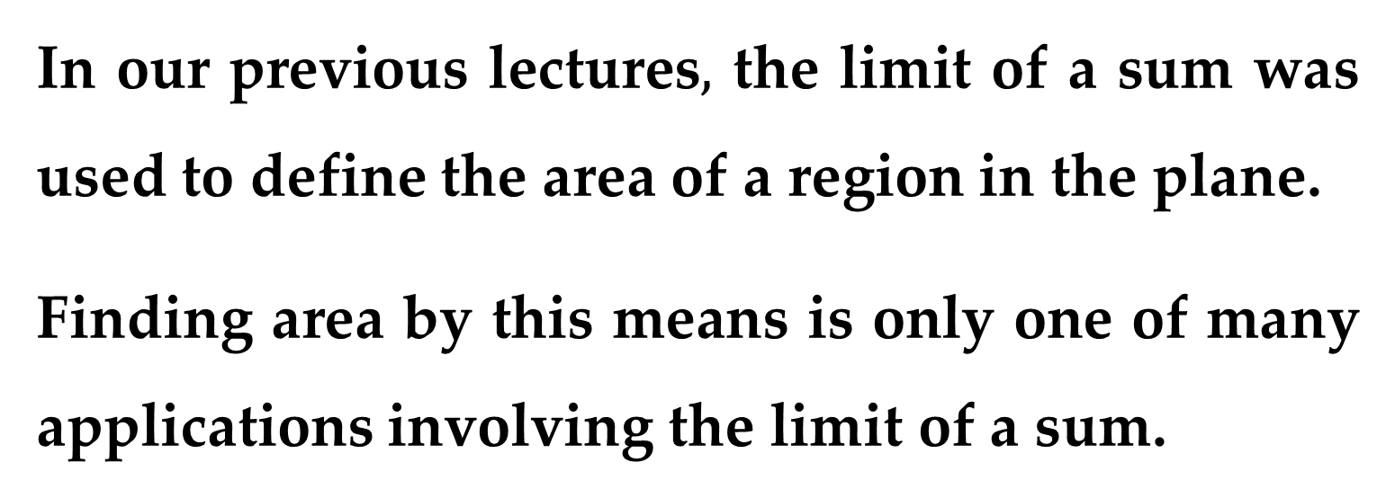
In our previous lectures$,$ the limit of a sum was used to define the area of a region in the plane.
Finding area by this means is only one of many applications involving the limit of a sum.

Slide 12
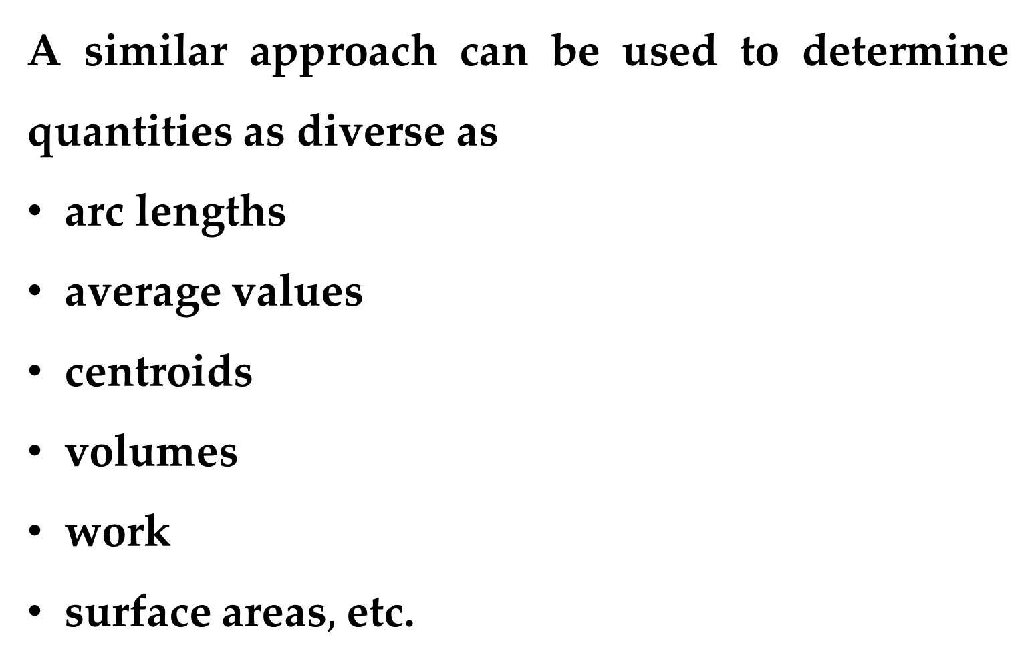
A similar approach can be used to determine quantities as diverse as
arc lengths
average values
centroids
volumes
work
surface areas$,$ etc.

Slide 13
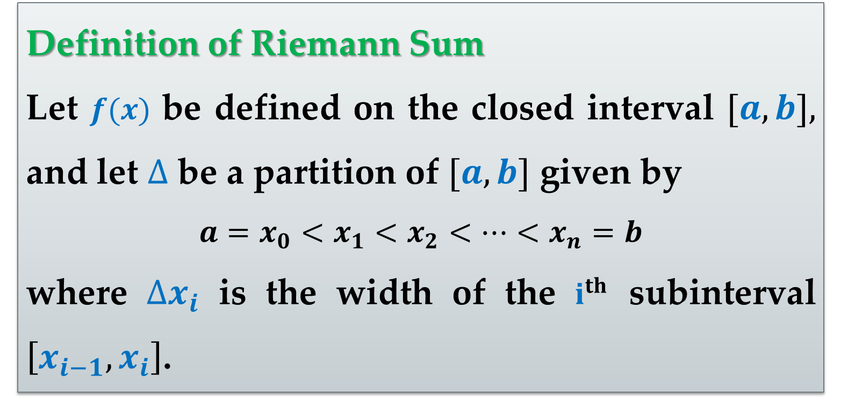
Definition of Riemann Sum
Let $f(x)$ be defined on the closed interval $[a,b],$ and let $∆$ be a partition of $[a,b]$ given by
$$a=x_{0}<x_{1}<x_{2}<…<x_{n}=b$$
where $∆x_{i}$ is the width of the $i^{th}$ subinterval $\left[x_{i−1},x_{i}\right]$.

Slide 14
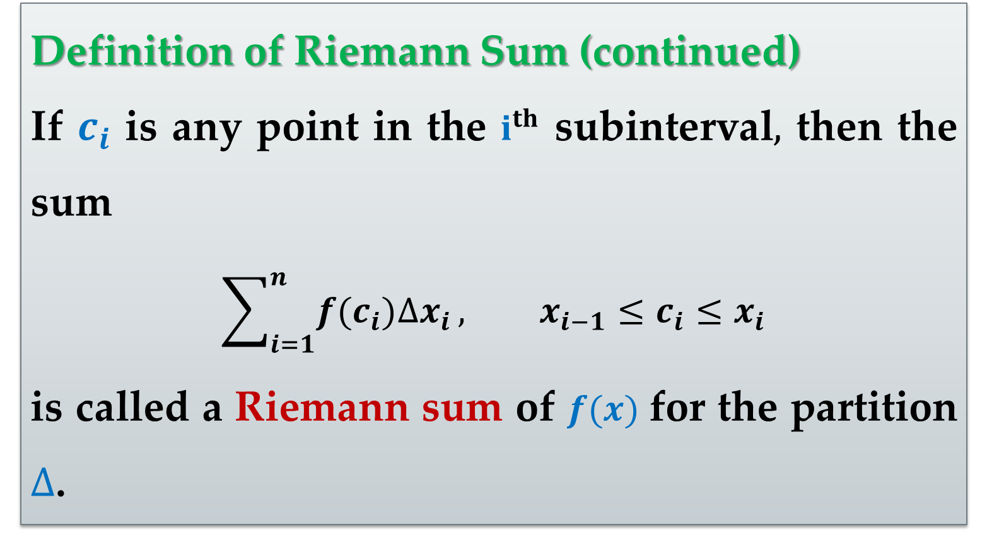
Definition of Riemann Sum (continued)
If $c_{i}$ is any point in the $i^{th}$ subinterval$,$ then the sum
$$\sum_{i=1}^{n}{f(c_{i})∆x_{i}}, x_{i−1}≤c_{i}≤x_{i}$$
is called a Riemann sum of $f(x)$ for the partition $∆$.

Slide 15
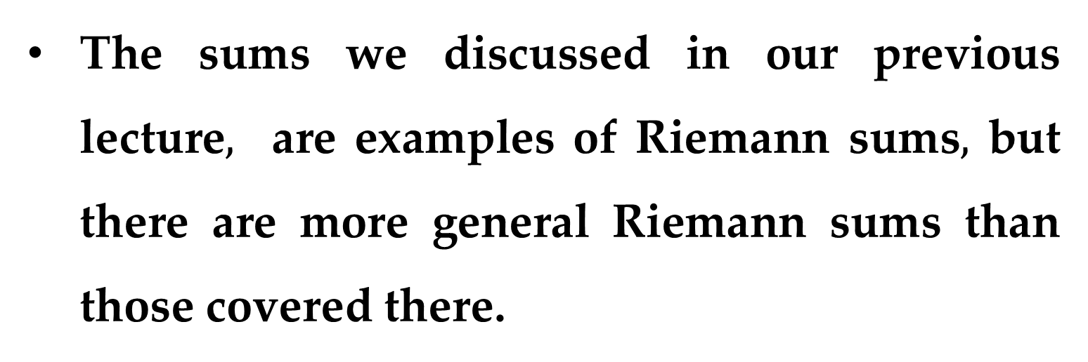
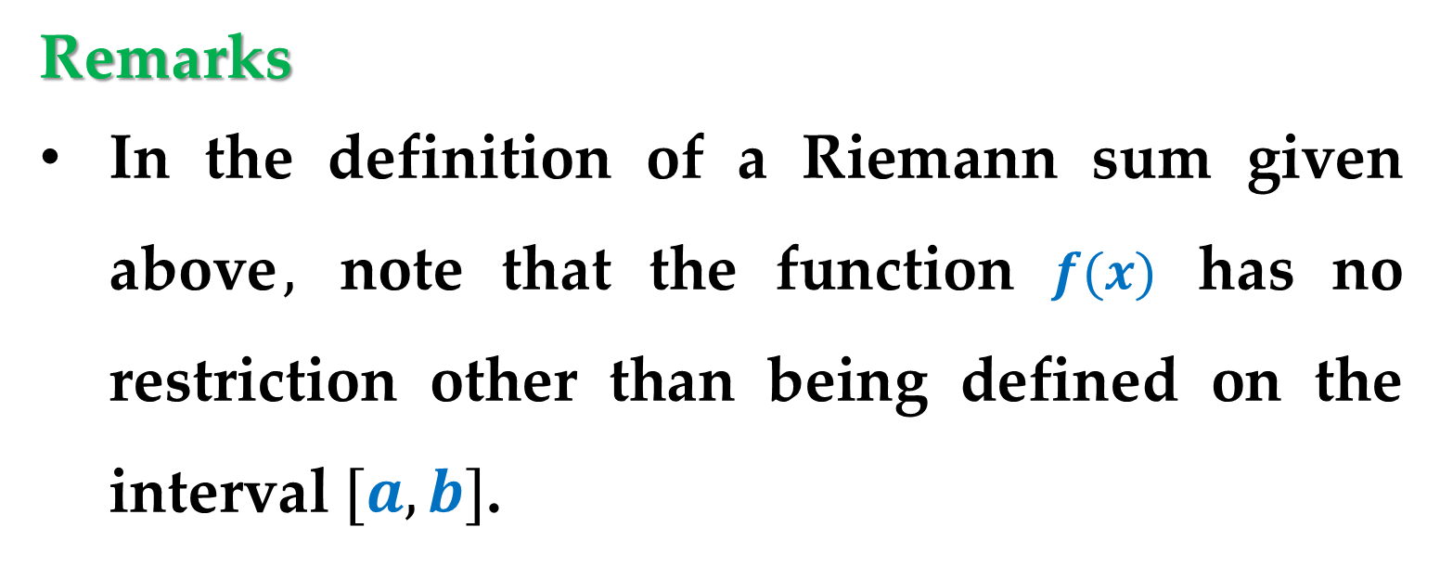
Remarks
In the definition of a Riemann sum given above$,$ note that the function $f(x)$ has no restriction other than being defined on the interval $[a,b]$.
The sums we discussed in our previous lecture$,$ are examples of Riemann sums$,$ but there are more general Riemann sums than those covered there.

Slide 16
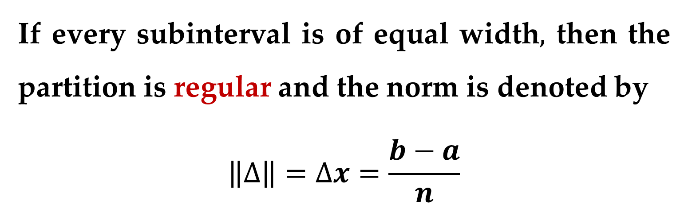
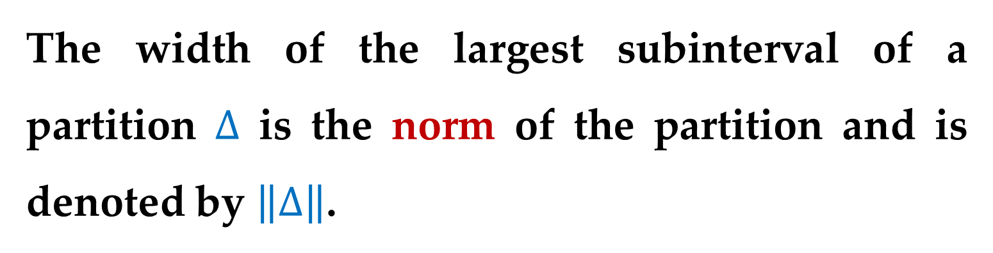
The width of the largest subinterval of a partition $∆$ is the norm of the partition and is denoted by $\left\|∆\right\|$.
If every subinterval is of equal width$,$ then the partition is regular and the norm is denoted by
$$\left\|∆\right\|=∆x=\frac{b−a}{n}$$

Slide 17
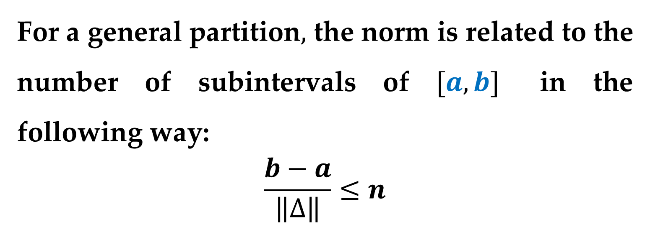
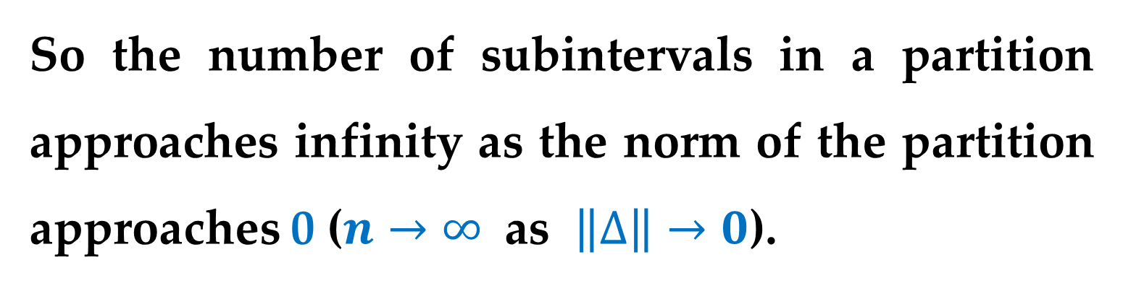
For a general partition$,$ the norm is related to the number of subintervals of $[a,b]$ in the following way:
$$\frac{b−a}{\left\|∆\right\|}≤n$$
So the number of subintervals in a partition approaches infinity as the norm of the partition approaches 0 ($n→∞ \text{as} \left\|∆\right\|→0$).

Slide 18
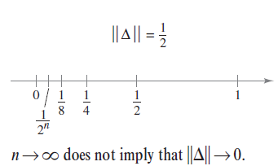
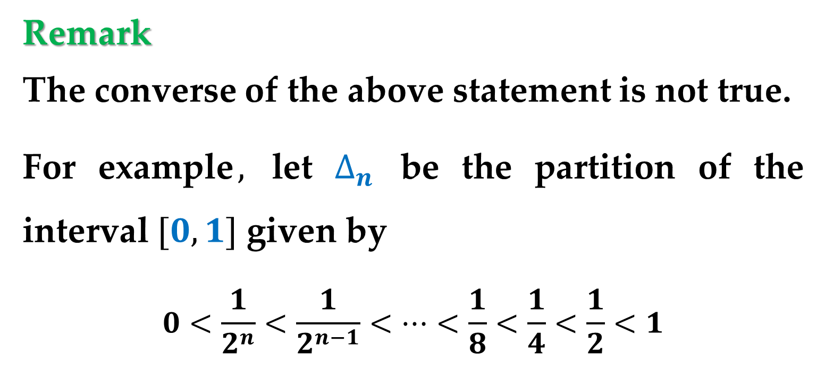
Remark
The converse of the above statement is not true.
For example$,$ let $∆_{n}$ be the partition of the interval $[0,1]$ given by
$$0<\frac{1}{2^{n}}<\frac{1}{2^{n−1}}<…<\frac{1}{8}<\frac{1}{4}<\frac{1}{2}<1$$

Slide 19
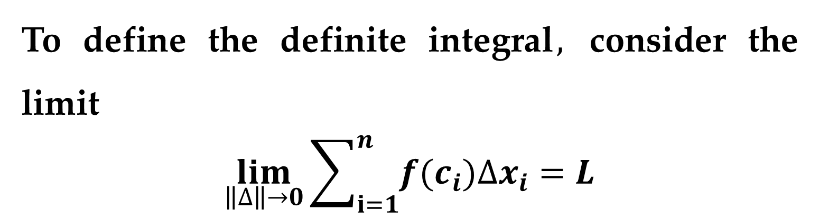
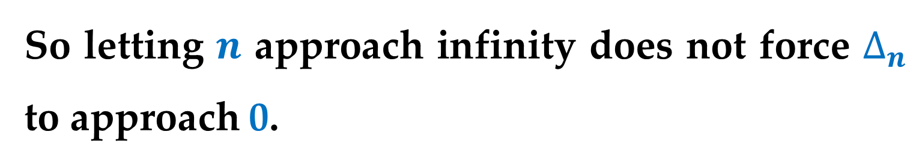
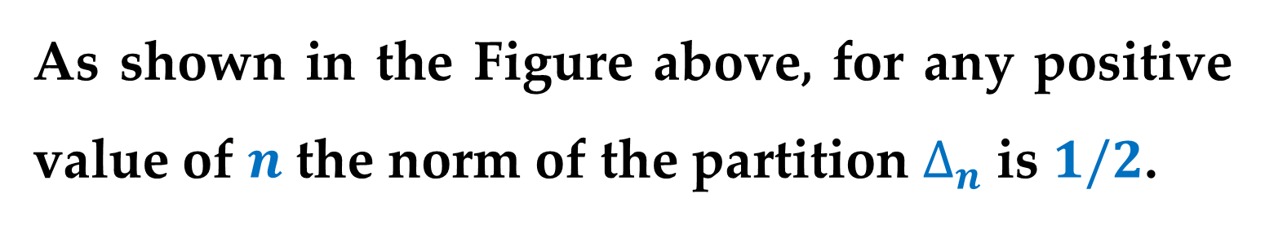
As shown in the Figure above, for any positive value of $n$ the norm of the partition $∆_{n}$ is $1/2$.
So letting $n$ approach infinity does not force $∆_{n}$ to approach 0.
To define the definite integral$,$ consider the limit
$$\lim_{\left\|∆\right\|→0}\sum_{i=1}^{n}{f(c_{i})∆x_{i}}=L$$

Slide 20
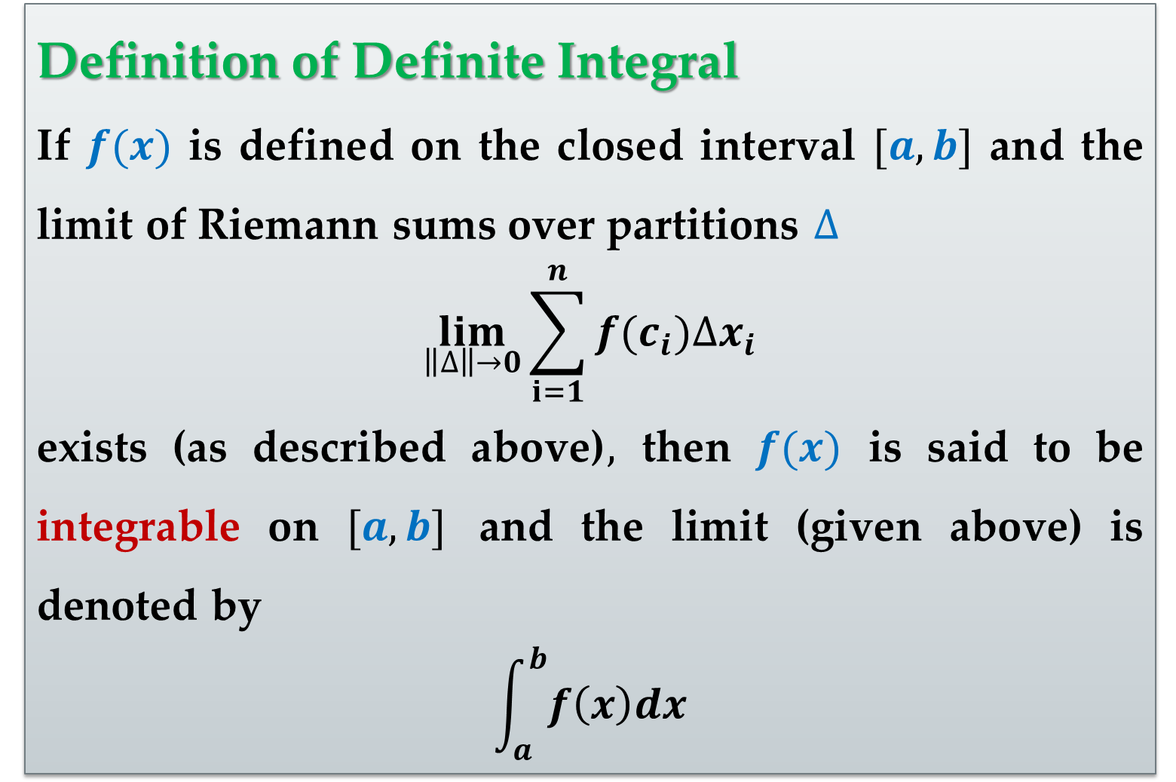
Definition of Definite Integral
If $f(x)$ is defined on the closed interval $[a,b]$ and the limit of Riemann sums over partitions $∆$
$$\lim_{\left\|∆\right\|→0}{\sum_{i=1}^{n}{f(c_{i})∆x_{i}}}$$
exists (as described above)$,$ then $f(x)$ is said to be integrable on $[a,b]$ and the limit (given above) is denoted by
$$\int_{a}^{b}{f\left(x\right)dx}$$

Slide 21
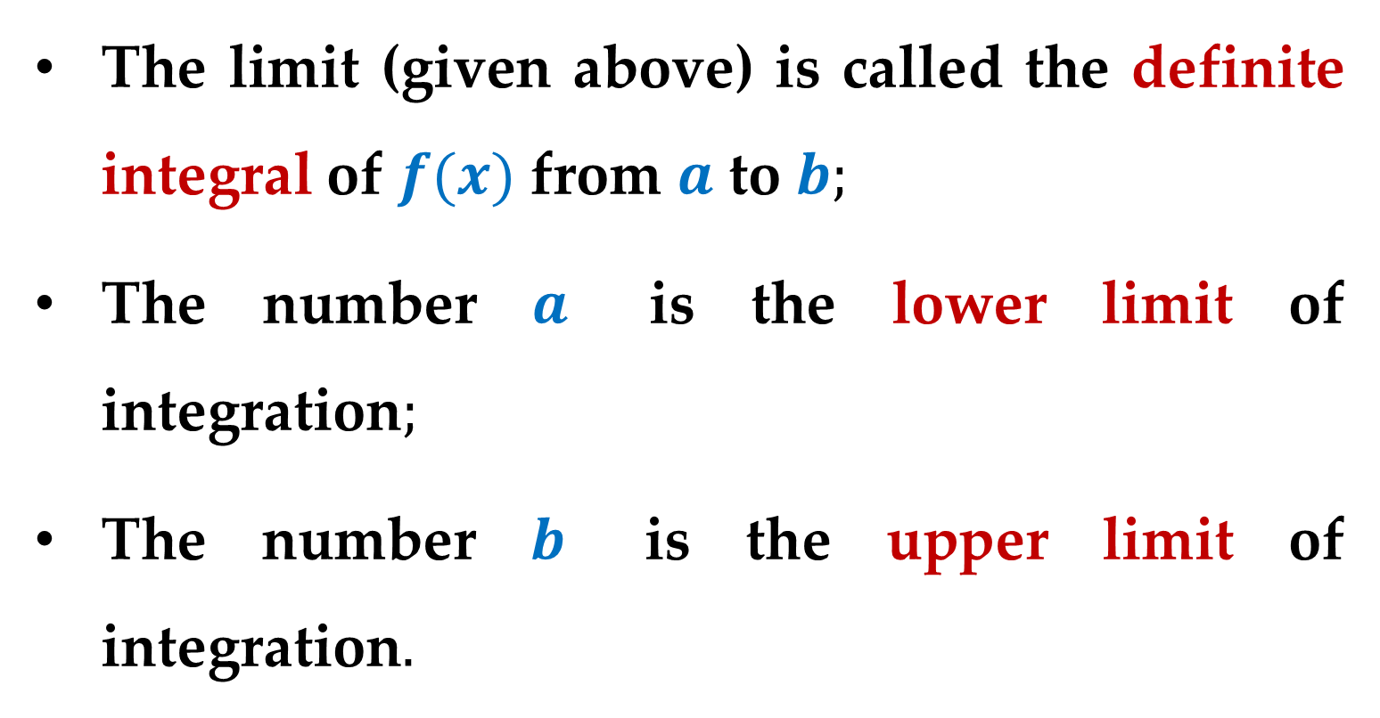
The limit (given above) is called the definite integral of $f(x)$ from $a$ to $b;$
The number $a$ is the lower limit of integration$;$
The number $b$ is the upper limit of integration$.$

Slide 22
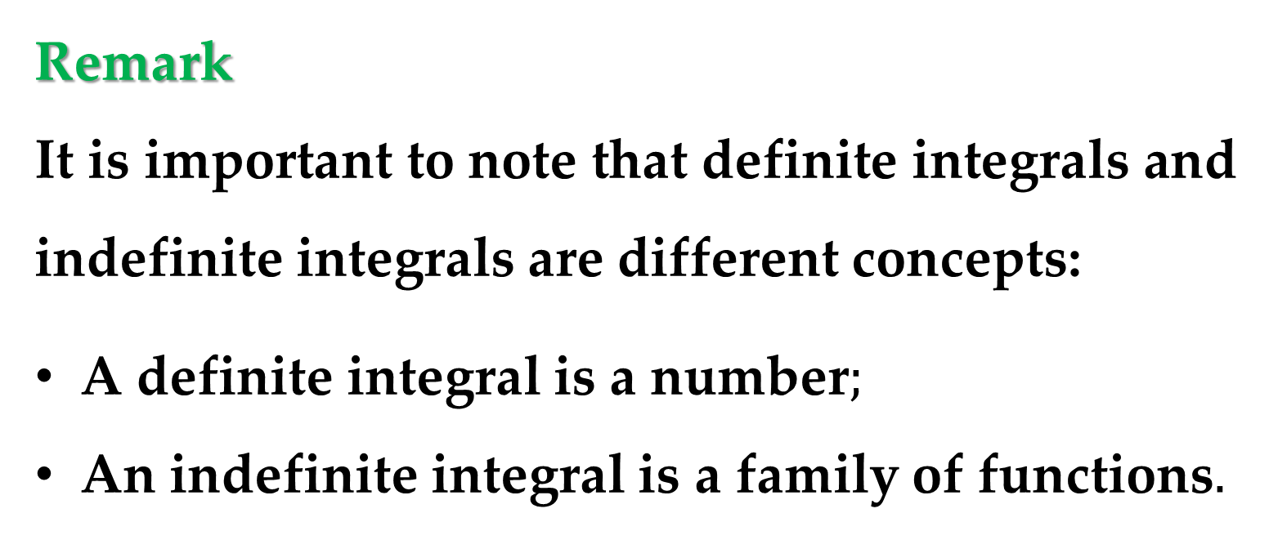
Remark
It is important to note that definite integrals and indefinite integrals are different concepts:
A definite integral is a number$;$
An indefinite integral is a family of functions$.$

Slide 23
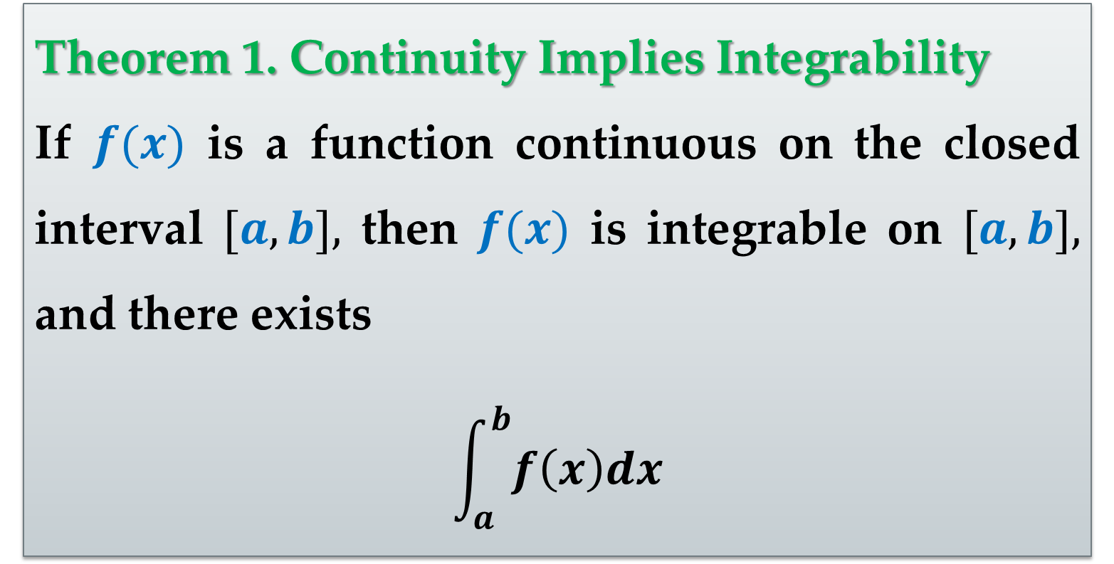
Theorem 1. Continuity Implies Integrability
If $f(x)$ is a function continuous on the closed interval $[a,b],$ then $f(x)$ is integrable on $[a,b],$ and there exists
$$\int_{a}^{b}{f\left(x\right)dx}$$

Slide 24
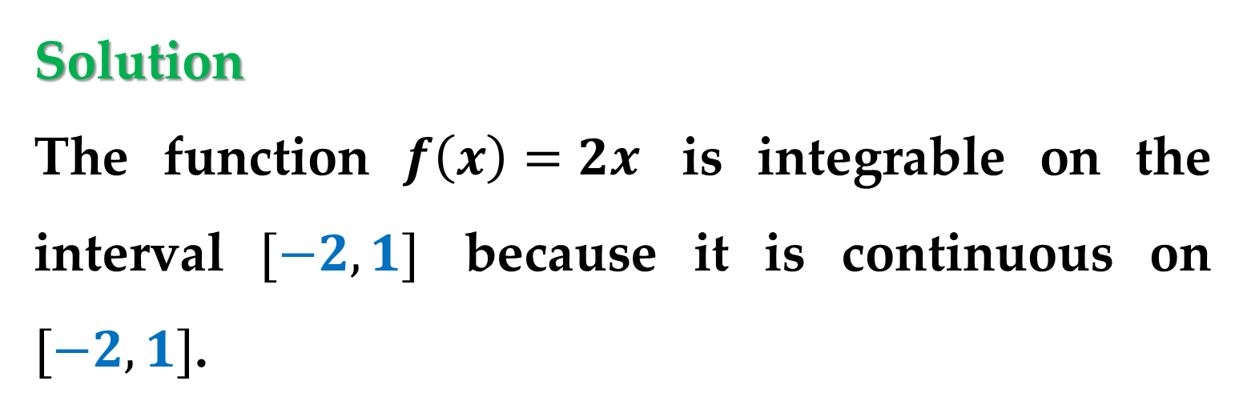
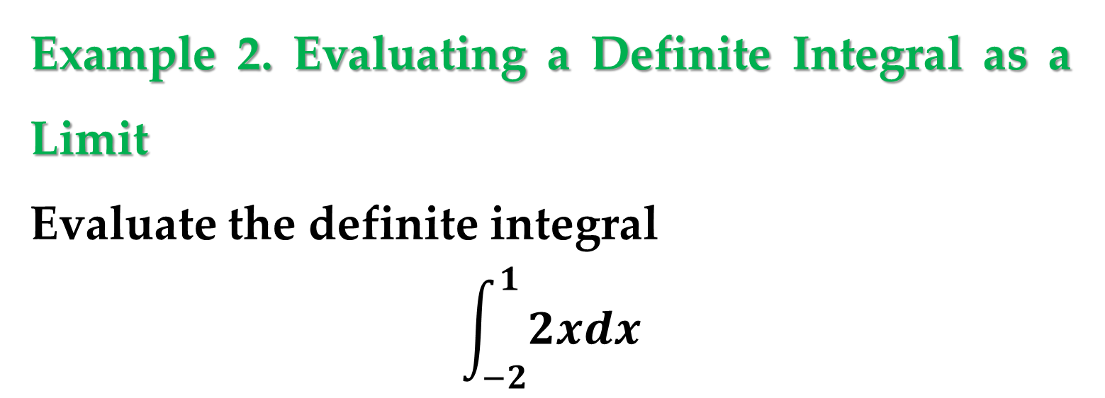
Example 2. Evaluating a Definite Integral as a Limit
Evaluate the definite integral
$$\int_{−2}^{1}{2xdx}$$
Solution
The function $f\left(x\right)=2x$ is integrable on the interval $[−2,1]$ because it is continuous on $[−2,1]$.

Slide 25
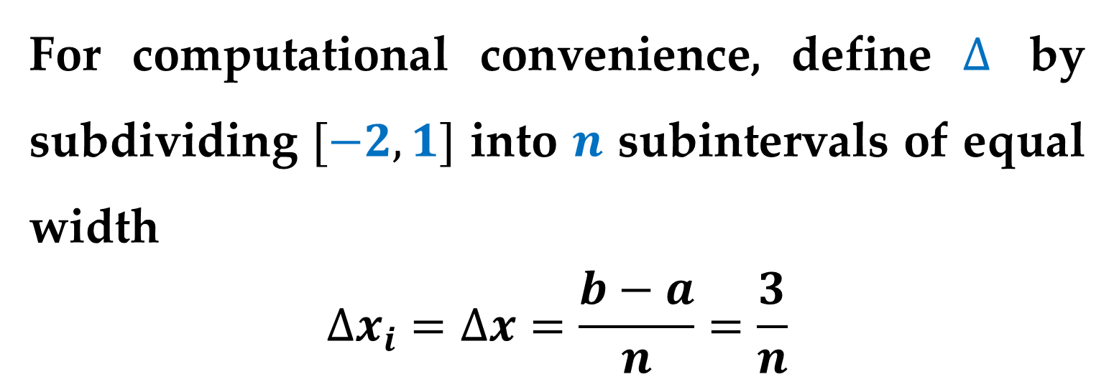
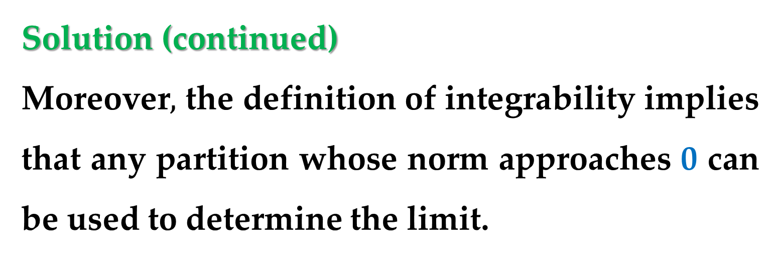
Solution (continued)
Moreover$,$ the definition of integrability implies that any partition whose norm approaches 0 can be used to determine the limit.
For computational convenience, define $∆$ by subdividing $[−2,1]$ into $n$ subintervals of equal width
$$∆x_{i}=∆x=\frac{b−a}{n}=\frac{3}{n}$$

Slide 26
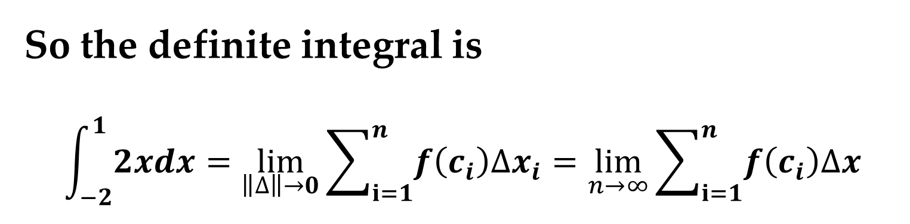
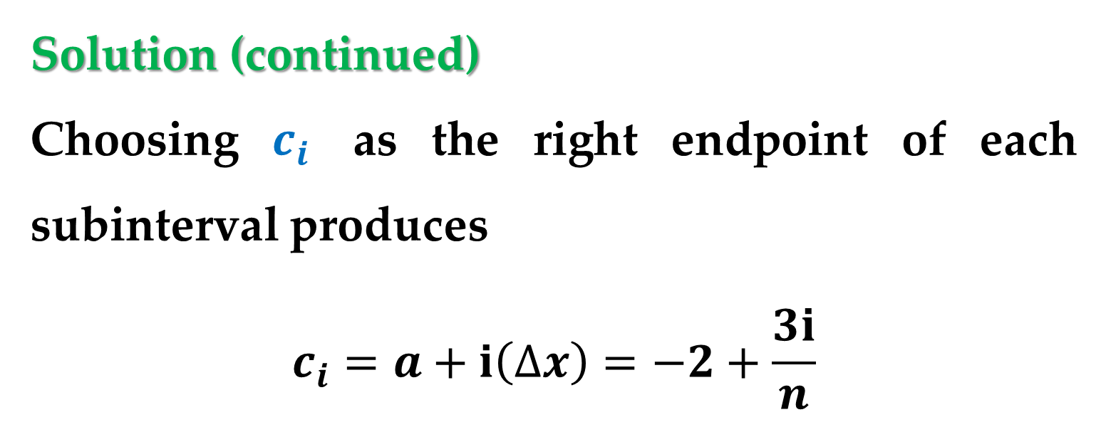
Solution (continued)
Choosing $c_{i}$ as the right endpoint of each subinterval produces
$$c_{i}=a+i\left(∆x\right)=−2+\frac{3i}{n}$$
So the definite integral is
$$\int_{−2}^{1}{2xdx}=\lim_{\left\|∆\right\|→0}{\sum_{i=1}^{n}{f\left(c_{i}\right)∆x_{i}}}=\lim_{n→∞}{\sum_{i=1}^{n}{f\left(c_{i}\right)∆x}}$$

Slide 27
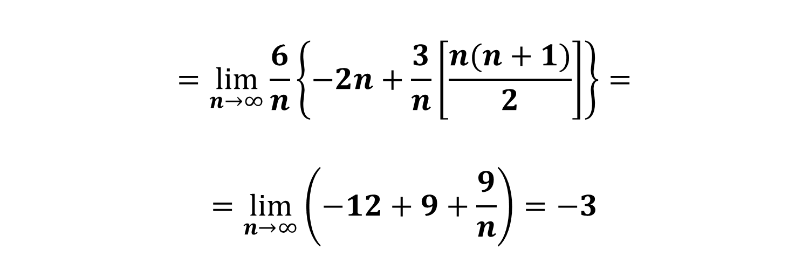
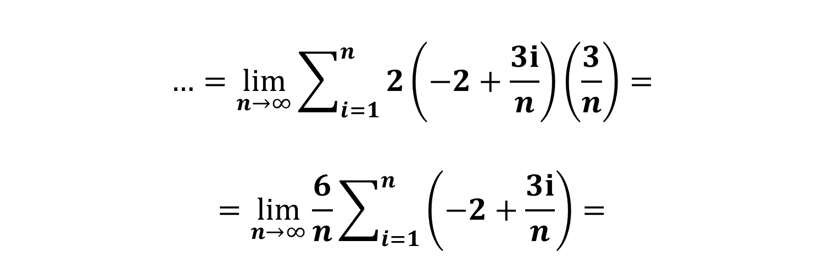
Solution (continued)
$$…=\lim_{n→∞}{\sum_{i=1}^{n}{2\left(−2+\frac{3i}{n}\right)\left(\frac{3}{n}\right)}=}$$
$$=\lim_{n→∞}{\frac{6}{n}\sum_{i=1}^{n}{\left(−2+\frac{3i}{n}\right)}}=$$
$$=\lim_{n→∞}{\frac{6}{n}\left\{−2n+\frac{3}{n}\left[\frac{n(n+1)}{2}\right]\right\}}=$$
$$=\lim_{n→∞}\left(−12+9+\frac{9}{n}\right)=−3$$

Slide 28
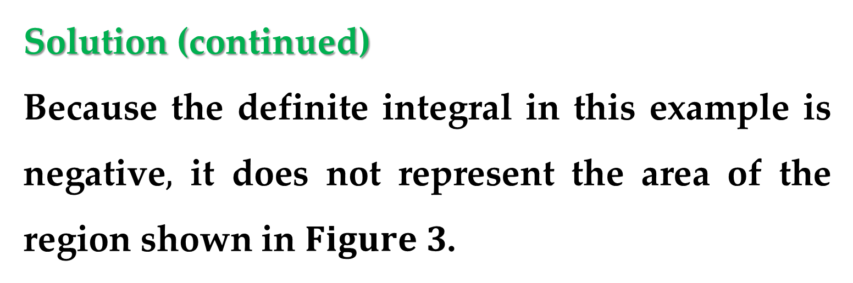
Solution (continued)
Because the definite integral in this example is negative$,$ it does not represent the area of the region shown in $Figure 3$.

Slide 29
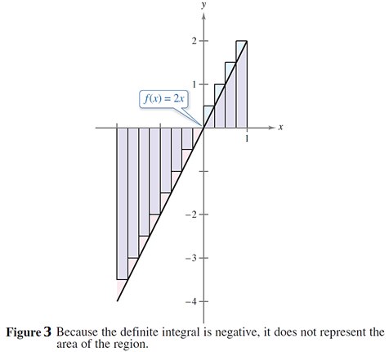
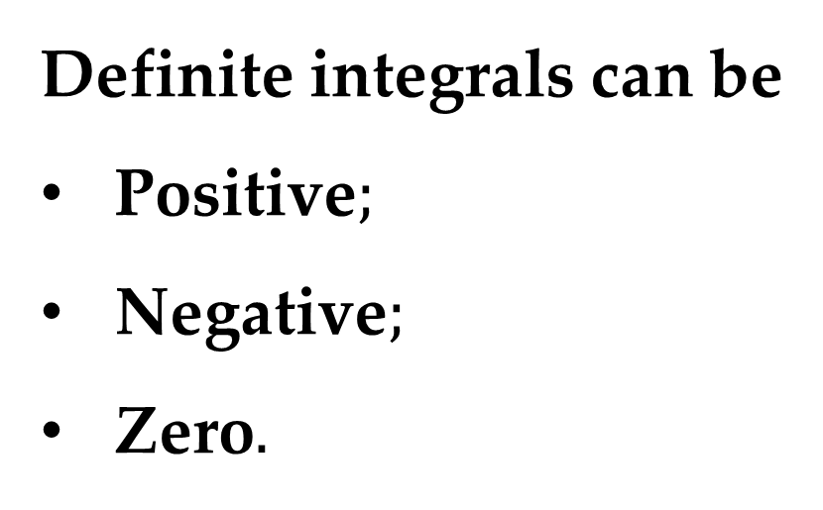
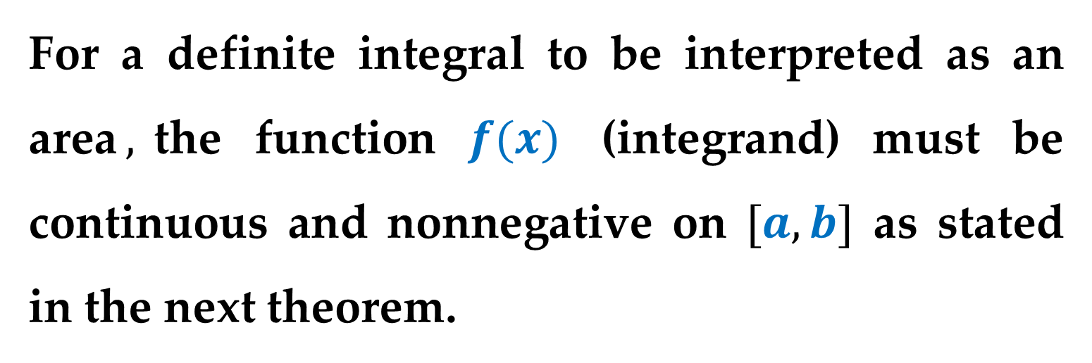
Solution (continued)
Definite integrals can be
Positive$;$
Negative$;$
Zero$.$
For a definite integral to be interpreted as an area$,$the function $f(x)$ (integrand) must be continuous and nonnegative on $[a,b]$ as stated in the next theorem.

Slide 30
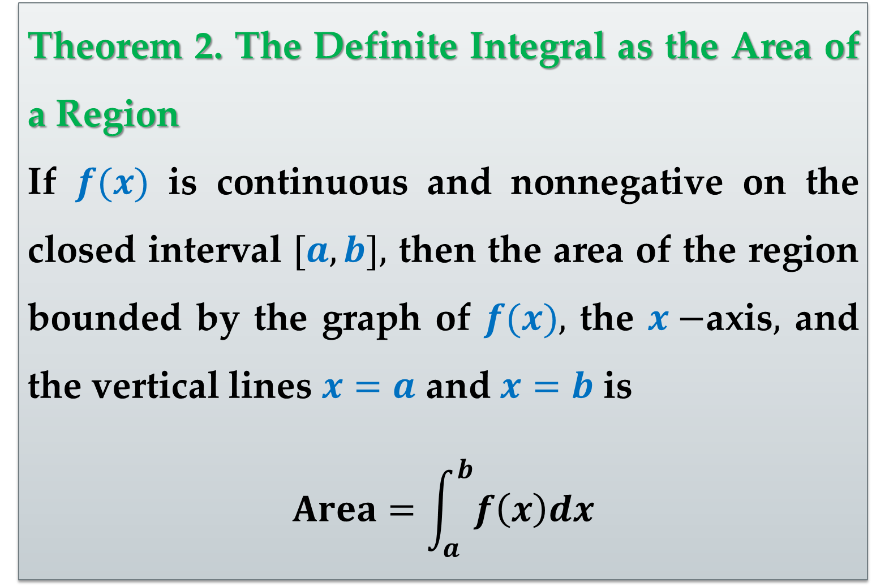
Theorem 2. The Definite Integral as the Area of a Region
If $f(x)$ is continuous and nonnegative on the closed interval $[a,b],$ then the area of the region bounded by the graph of $f(x),$ the $x−$axis$,$ and the vertical lines $x=a$ and $x=b$ is
$$Area=\int_{a}^{b}{f\left(x\right)dx}$$

Slide 31
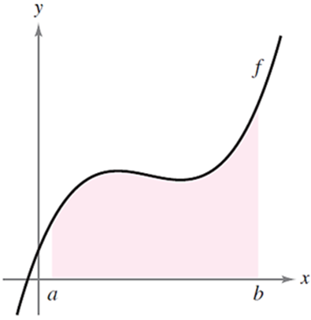
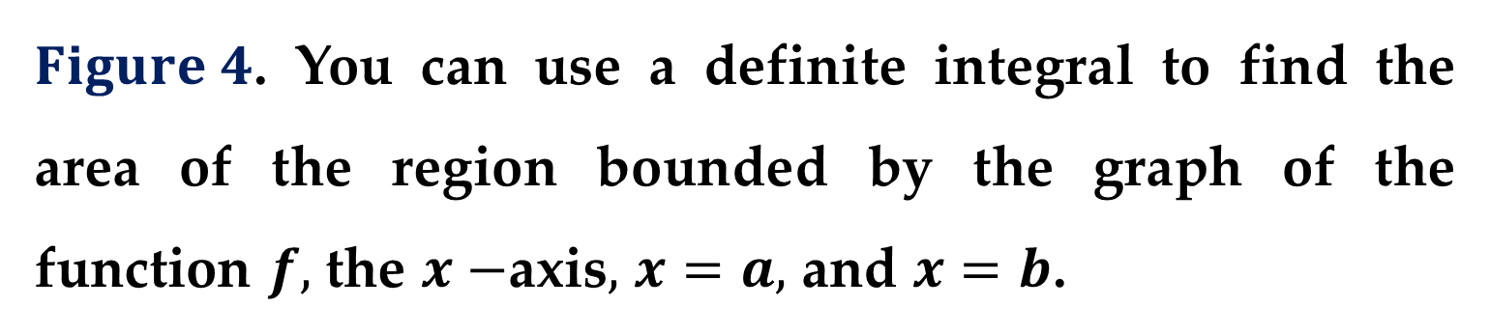
$Figure 4$. You can use a definite integral to find the area of the region bounded by the graph of the function $f,$ the $x−$axis$,$ $x=a,$ and $x=b$.

Slide 32
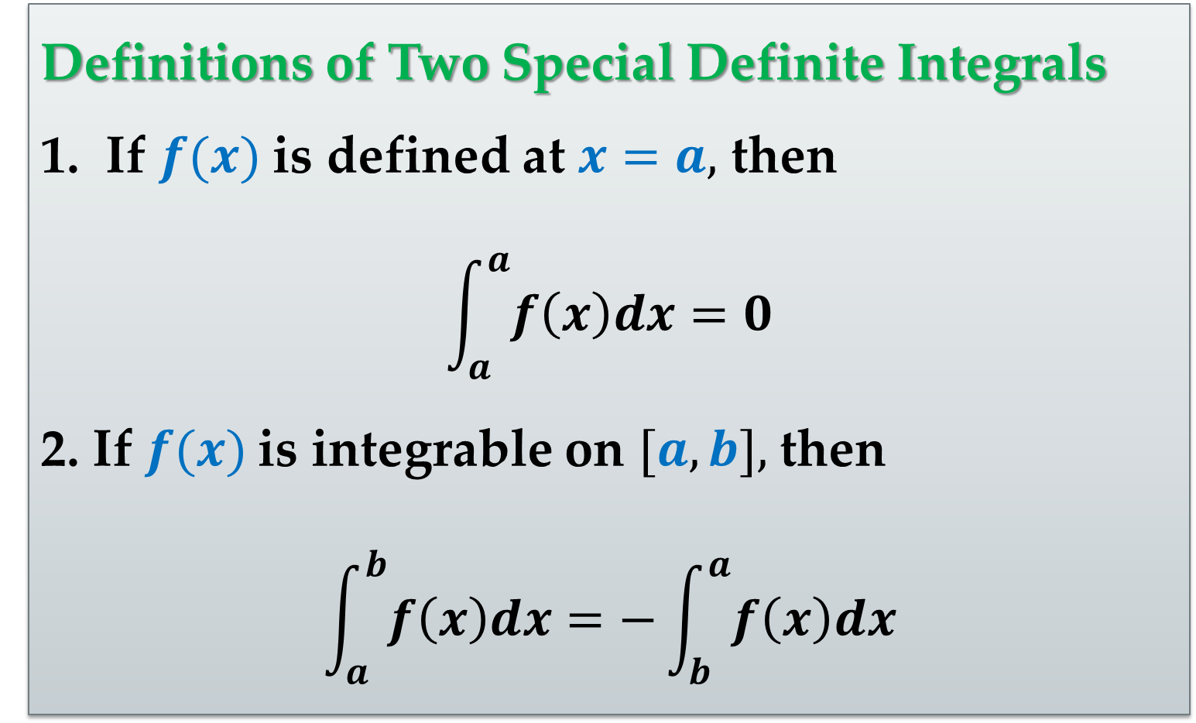
Definitions of Two Special Definite Integrals
If $f(x)$ is defined at $x=a,$ then
$$\int_{a}^{a}{f\left(x\right)dx}=0$$
2. If $f(x)$is integrable on $[a,b],$ then
$$\int_{a}^{b}{f\left(x\right)dx}=−\int_{b}^{a}{f\left(x\right)dx}$$

Slide 33
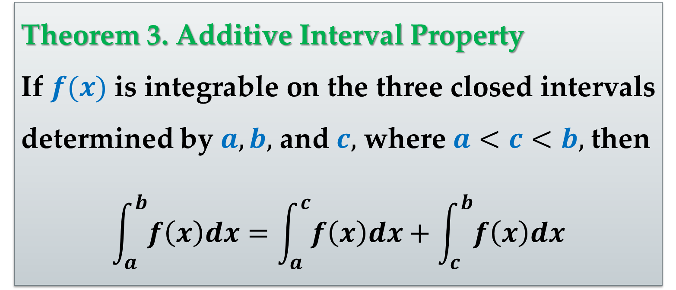
Theorem 3. Additive Interval Property
If $f(x)$ is integrable on the three closed intervals determined by $a,b,$ and $c,$ where $a<c<b,$ then
$$\int_{a}^{b}{f\left(x\right)dx}=\int_{a}^{c}{f\left(x\right)dx}+\int_{c}^{b}{f\left(x\right)dx}$$

Slide 34



In $Figure 5,$ the larger region can be divided at $x=c$ into two subregions whose intersection is a line segment.
Because the line segment has zero area$,$ it follows that the area of the larger region is equal to the sum of the areas of the two smaller regions.

Slide 35


Example 3. Using the Additive Interval Property
Find the definite integral
$$\int_{−1}^{1}{\left|x\right|dx}$$
Solution
Let$’$s split this definite integral into two parts (according to $Theorem 3$):
$$\int_{−1}^{1}{\left|x\right|dx}=\int_{−1}^{0}{(−x)dx}+\int_{0}^{1}{xdx}$$

Slide 36


Solution (continued)
Next, consider these two newly obtained definite integrals separately:
$$\int_{−1}^{0}{(−x)dx} and \int_{0}^{1}{xdx}$$
Let$’$s sketch the region corresponding to each definite integral and evaluate each integral using a geometric formula.

Slide 37


Solution (continued)
$(a)$ Consider the definite integral
$$\int_{−1}^{0}{(−x)dx}$$
The region bounded by the graph of the function $f_{1}\left(x\right)=−x,$ the $x−$axis$,$ and the vertical lines $x=−1$ and $x=0,$ is a trapezoid with an altitude of 1 and parallel bases of lengths 1 and 0.

Slide 38

Solution (continued)
The formula for the area of a trapezoid is
$$\frac{h}{2}\left(b_{1}+b_{2}\right)$$
So we obtain:
$$\int_{−1}^{0}{(−x)dx}=\frac{1}{2}1\left(1+0\right)=\frac{1}{2}$$

Slide 39


Solution (continued)
$(b)$ Consider the definite integral
$$\int_{0}^{1}{xdx}$$
The region bounded by the graph of the function $f_{2}\left(x\right)=x,$ the $x−$axis$,$ and the vertical lines $x=0$ and $x=1,$ is again a trapezoid with an altitude of 1 and parallel bases of lengths 0 and 1.

Slide 40


Solution (continued)
The formula for the area of a trapezoid is $\frac{h}{2}\left(b_{1}+b_{2}\right)$. So$,$ we obtain:
$$\int_{0}^{1}{xdx}=\frac{1}{2}1\left(0+1\right)=\frac{1}{2}$$
By adding the values obtained in $(a)$ and $(b),$ we obtain the value of the definite integral as
$$\frac{1}{2}+\frac{1}{2}=1$$

Slide 41

Theorem 4. Properties of Definite Integrals
If $f(x)$ and $g(x)$ are integrable on $[a,b]$ and $c$ is a constant$,$ then the functions $cf(x)$ and $f(x)±g(x)$ are integrable on $[a,b],$ too$,$ and
$$\int_{a}^{b}{cf\left(x\right)dx}=c\int_{a}^{b}{f\left(x\right)dx}$$
$$\int_{a}^{b}{[f\left(x\right)±g(x)]dx}=\int_{a}^{b}{f\left(x\right)dx}±\int_{a}^{b}{g\left(x\right)dx}$$

Slide 42


Theorem 5. Preservation of Inequality
$(1)$ If $f(x)$ is integrable and nonnegative on the closed interval $[a,b],$ then
$$0≤\int_{a}^{b}{f\left(x\right)dx}$$
$(2)$ If $f(x)$ and $g(x)$ are integrable on the closed interval $[a,b]$ and $f(x)≤g(x)$ for every $x∈[a,b],$ then
$$\int_{a}^{b}{f\left(x\right)dx}≤\int_{a}^{b}{g\left(x\right)dx}$$

Slide 43

The assertion of the theorem is illustrated in the following figure.

Slide 44


Example 4. Evaluation of a Definite Integral
Evaluate
$$\int_{1}^{3}{\left(4x−3\right)dx}$$
Solution
According to $Theorem 4$ we can split this definite integral into two parts:
$$\int_{1}^{3}{\left(4x−3\right)dx}=\int_{1}^{3}{4xdx}−\int_{1}^{3}{3dx}$$

Slide 45


Solution (continued)
Let$’$s sketch the region corresponding to each definite integral.
$(a)$ Consider the definite integral
$$\int_{1}^{3}{4xdx}$$
This region is a trapezoid with an altitude of $2$ and parallel bases of lengths $4$ and $12$.

Slide 46

Solution (continued)
The formula for the area of a trapezoid is
$$\frac{1}{2}h(b_{1}+b_{2})$$
So
$$\int_{1}^{3}{4xdx}=\frac{1}{2}2\left(4+12\right)=16$$

Slide 47

Solution (continued)
$(b)$ Consider the definite integral
$$\int_{1}^{3}{3dx}$$
The region bounded by the given definite integral represents a rectangle of height $3$ and width $2$.

Slide 48


Solution (continued)
So
$$\int_{1}^{3}{3dx}=3∙2=6$$
Subtracting the values of these two definite integrals$,$ $(a)$ and $(b),$ we get the resulting definite integral$’$s value:
$$\int_{1}^{3}{\left(4x−3\right)dx}=16−6=10$$

Slide 49

Example 5. Evaluation of a Definite Integral
Evaluate
$$\int_{1}^{3}{\left(−x^{2}+4x−3\right)dx}$$
using any Riemann sum and the properties of the definite integration.
$$∗∗∗$$

Slide 50




$$\int_{1}^{3}{\left(−x^{2}+4x−3\right)dx}=\int_{1}^{3}{\left(−x^{2}\right)dx}+\int_{1}^{3}{\left(4x\right)dx}+\int_{1}^{3}{\left(−3\right)dx}$$
$$−\int_{1}^{3}{x^{2}dx}+4\int_{1}^{3}{x dx}−1\int_{1}^{3}{3dx}$$
$$\int_{1}^{3}{3dx}=3×\left(3−1\right)=6$$
$$\int_{1}^{3}{x dx}=\frac{\left(3−1\right)}{2}×\left(1+3\right)=4$$

Slide 51

$$\int_{1}^{3}{x^{2}dx}=\lim_{\left\|∆\right\|}{\sum_{i=1}^{n}{f\left(c_{i}\right)∆x_{i}}}=\lim_{n→∞}{\sum_{i=1}^{n}{f\left(c_{i}\right)∆x}}$$
$$∆x=\frac{3−1}{n}=\frac{2}{n}; c_{i}=1+i\frac{2}{n} (i=0,1,2,…,n)$$
$$\lim_{n→∞}{\sum_{i=1}^{n}{f\left(c_{i}\right)∆x}}=\lim_{n→∞}{\sum_{i=1}^{n}{{\left(1+\frac{2i}{n}\right)}^{2}\frac{2}{n}}}=$$
$$=\lim_{n→∞}\frac{2}{n^{3}}\sum_{i=1}^{n}{{\left(n+2i\right)}^{2}}=\lim_{n→∞}\frac{2}{n^{3}}\sum_{i=1}^{n}{n^{2}+4in+4i^{2}}$$

Slide 52

$$\lim_{n→∞}\frac{2}{n^{3}}\sum_{i=1}^{n}{n^{2}+4in+4i^{2}}=$$
$$\lim_{n→∞}\frac{2}{n^{3}}\left\{\sum_{i=1}^{n}{n^{2}}+\sum_{i=1}^{n}{4in}+\sum_{i=1}^{n}{4i^{2}}\right\}$$
$$\sum_{i=1}^{n}{n^{2}}=n^{2}\sum_{i=1}^{n}{1}=n^{2}×n=n^{3}$$
$$\sum_{i=1}^{n}{4in}=4n\sum_{i=1}^{n}{i}=4n×\frac{n\left(n+1\right)}{2}=2n^{2}\left(n+1\right)$$
$$\sum_{i=1}^{n}{4i^{2}}=4\sum_{i=1}^{n}{i^{2}}=2\frac{n\left(n+1\right)\left(2n+1\right)}{3}$$

Slide 53

$$\lim_{n→∞}\frac{2}{n^{3}}\left\{n^{3}+2n^{2}\left(n+1\right)+2\frac{n\left(n+1\right)\left(2n+1\right)}{3}\right\}=$$
$$=\lim_{n→∞}\frac{2}{n^{3}}\left\{n^{3}\right\}+\lim_{n→∞}\frac{4}{n^{3}}\left\{n^{3}+n^{2}\right\}+$$
$$\lim_{n→∞}\frac{4}{3n^{3}}\left\{n\left(n+1\right)\left(2n+1\right)\right\}=$$
$$=2+4+\frac{8}{3}=6+\frac{8}{3}=\frac{26}{3}$$
$$\left(n^{2}+n\right)\left(2n+1\right)=2n^{3}+3n^{2}+n$$

Slide 54

$$\int_{1}^{3}{\left(−x^{2}+4x−3\right)dx}=\int_{1}^{3}{\left(−x^{2}\right)dx}+\int_{1}^{3}{\left(4x\right)dx}+\int_{1}^{3}{\left(−3\right)dx}=$$
$$=−\frac{26}{3}+16−6=10−\frac{26}{3}=\frac{4}{3}$$

Slide 55
Thank you for attention

